Slide 1
Face Anti-Spoofing

Slide 2
What is Face Anti Spoofing
Liveness detection in biometrics is the ability of a system to detect if a biometric is real or fake at the point of capture
Specifically, Facial anti-spoofing is the task of preventing false facial verification by using a photo, video, mask or a different substitute for an authorized person’s face.

Slide 3
Types of Presentation Attacks
 | Static | Dynamic
2D | Photographs, Flat paper/plastic Mask | Screen Video Replay, Several Photographs shown one by one
3D | 3D print sculpture mask | Robots that reproduce expressions

Slide 4
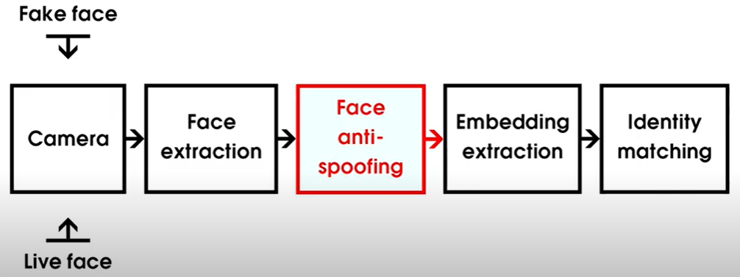
How Does it Work

Slide 5
NOW,
THE REAL QUESTION IS

Slide 6
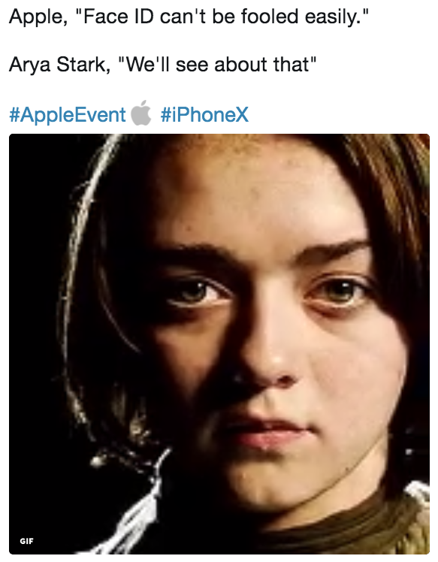

Slide 7
The Comprehensive Review of Face Anti-Spoofing Techniques

Slide 8
Face Anti-Spoofing Techniques
Texture method
Deep Learning Based Methods
Motion Based Methods

Slide 9
Texture Based Methods
Texture based methods concentrate on shape, size, color, arrangement, and the density of an image
The widely adopted texture based features include:
Local Binary Patterns (LBP)
Histogram of Oriented Gradients(HOG)
Scale Invariant Feature Transform (SIFT)
Speeded-Up Robust Features (SURF)
Difference of Gaussian (DoG)

Slide 10
Problems with Texture Based Methods
Suffers from poor generalization because the texture information varies with cameras/capture devices
Texture information is not as discriminative as the depth information on task of 2D presentation attack detection.

Slide 11
Deep Learning Based Methods
01
Face Antispoofing Network (FASNet) Architecture
Transfer Learning on fully connected layers of VGG16 CNN Architecture
02
Depth-basedCNN & Patch-based CNN
Patch Scores from Patch-based CNN
Depth Features from Depth-based CNN passed into SVM
03
DeepColorFASD
Plane of each color space passed to get color score from Softmax
Fusion-based Voting Method
04
Resnet50 with LSTM
LSTM units were used to extract temporal features.

Slide 12
Motion Based Methods
Eye-Blinking
Hand/Lips movements
Any kind of Actions(Hand waving)
If there is no movement in the background or high movement in the foreground then output is real, otherwise output is fake

Slide 13
A Dataset and Benchmark for Large-scale Multi-modal Face Anti-Spoofing

Slide 14

Some Concepts from the Paper
CASIA-SURF Dataset
A multi-modal face anti-spoofing dataset
Modalities- RGB, Depth, IR
RGB data has rich appearance details
Depth data are sensitive to the distance between the image plane and the corresponding face
The IR data measure the amount of heat radiated from a face.

Slide 15
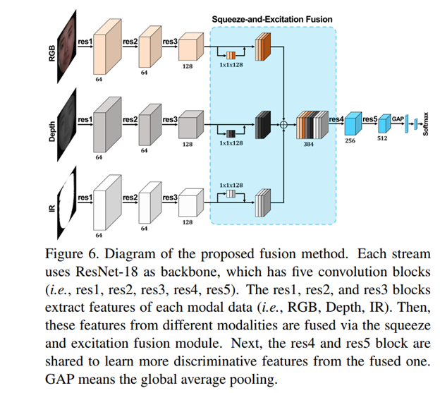

Slide 16
Multi-modal Face Anti-spoofing Attack Detection Challenge at CVPR2019

Slide 17

Teams in the Challenge
Vision Labs
FeatherNet

Slide 18
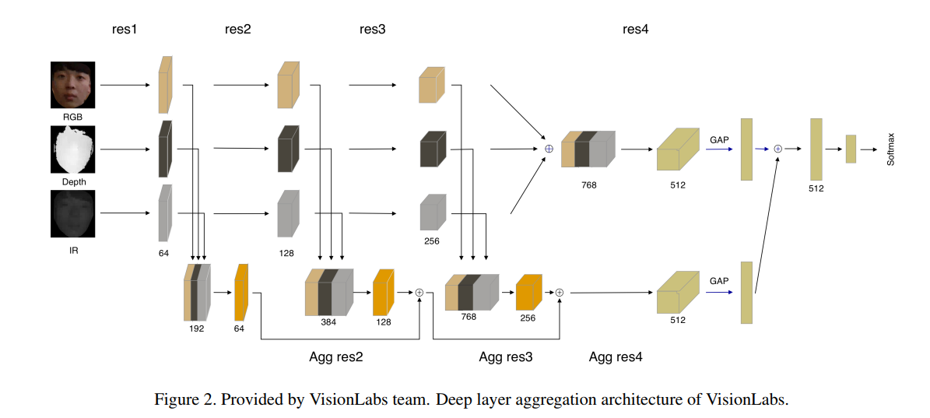
VisionLabs
RGB, Depth and IR inputs
were processed by
Separate streams followed
by concatenation and
fully-connected layers
Github Source : https://github.com/AlexanderParkin/ChaLearn_liveness_challenge

Slide 19
Feather Nets
Process multi-modal images sequentially in a cascaded network.
Depth information plays a key role between live and spoof faces.
IR data was adopted in at end of network
IR data measures the amount of heat radiated from a face which can provides strong error correction for reducing false positive samples greatly.

Slide 20
Feather Nets
Therefore, the process is divided into the following two stages:
Stage 1: Four ensemble networks with depth modal as input respectively and output the scores of classification by voting.
Stage 2: A MobileLiteNet followed by stage 1 which takes the IR modal as input to judge the fake samples further.
The basic networks of these two phases are Fishnet and MobileNetv2 respectively.

Slide 21
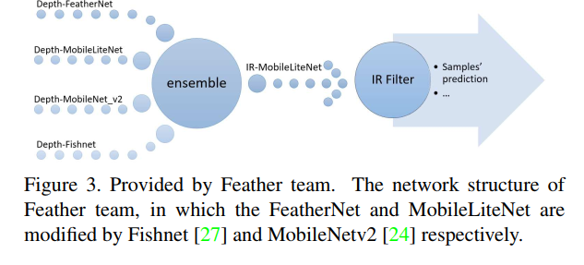
Github Source : https://github.com/SoftwareGift/FeatherNets_Face-Anti-spoofing-Attack-Detection-Challenge-CVPR2019

Slide 22
Multi-Modal Face Anti-Spoofing Based on Central Difference Convolutional Networks

Slide 23
CDCN
State of the art
All the multi-modal FAS methods rely on standard backbone (ResNet) with stacked vanilla convolutions which is weak in describing detailed intrinsic information
Trained on CASIA-SURF CeFA dataset which covers three ethnicities, three modalities
Github Source : https://github.com/ZitongYu/CDCN

Slide 24
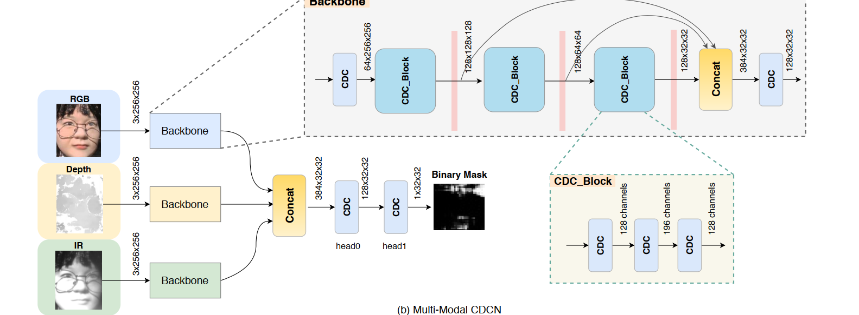

Slide 25
WHY FEATHERNET OVER CDCN
Features | FeatherNet | CDCN
Availability of Pretrained Models
Good for Mobile and Embedded Devices

Slide 26
NEXT STEPS
Studying on Pretrained FeatherNet Architecture
Research on Transfer Learning of FeatherNet
Building a model

Slide 27
Thanks!
Any questions?

